Slide 1
HW #3 Feedback/Rubric Score ____/20
Complete requested technical work in Tableau: _____/10
4 areas of analysis (zip code, property type, plus two additional)
A Tableau Dashboard
A Tableau Story
A map visualization
A Packaged workbook (.twbx file)
Professional presentation and analysis: _____/10
Client introduced
Presentation tells a story
Story improved over HW2
Final recommendation supported by data and visualizations
Professional slides

Slide 2
Homework #3
Gage Gutmann

Slide 3
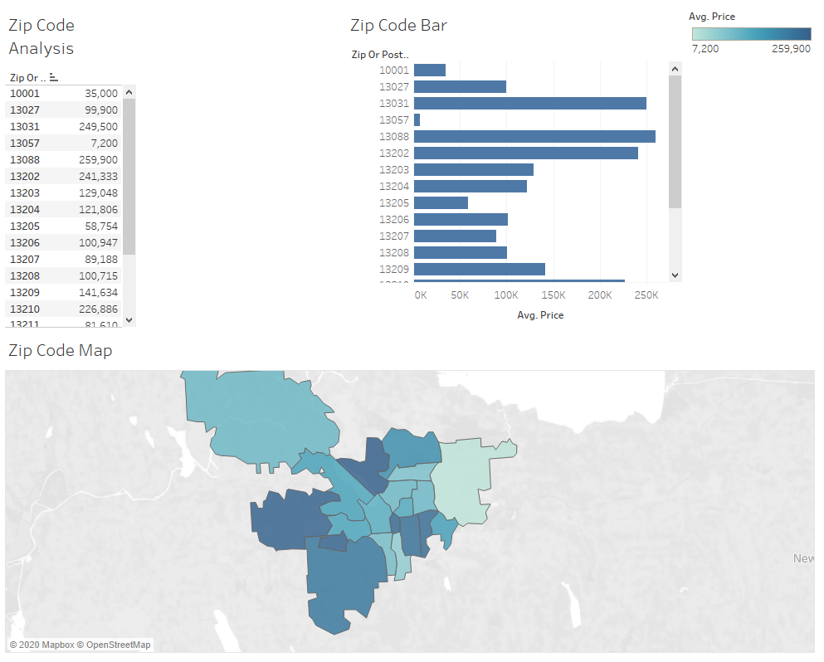

Slide 4
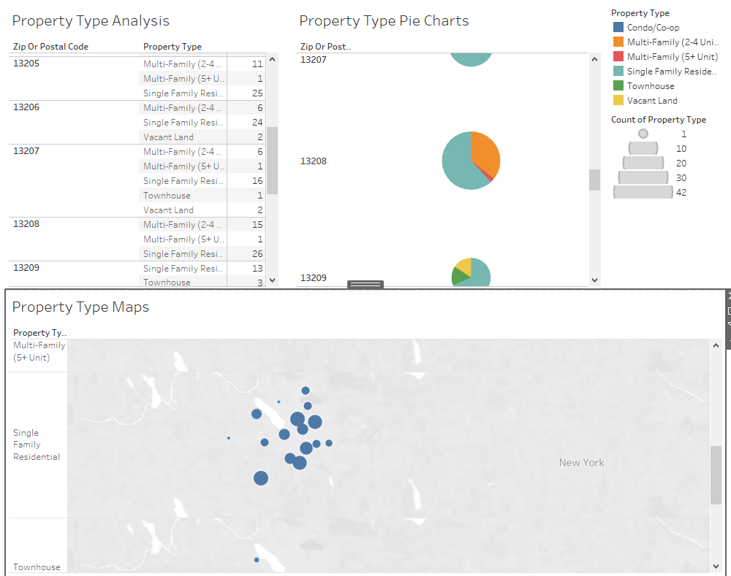

Slide 5
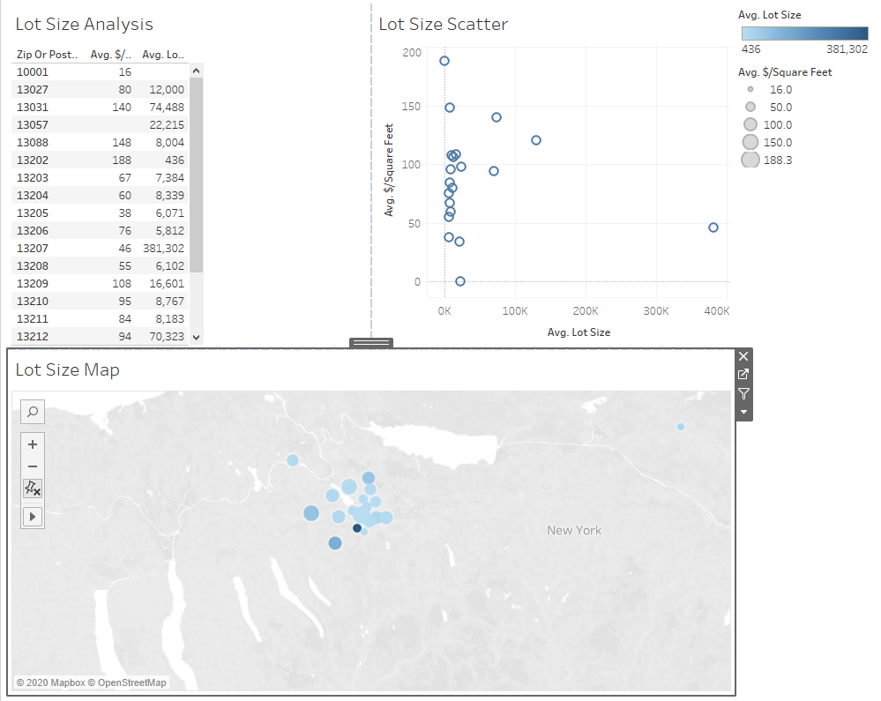

Slide 6
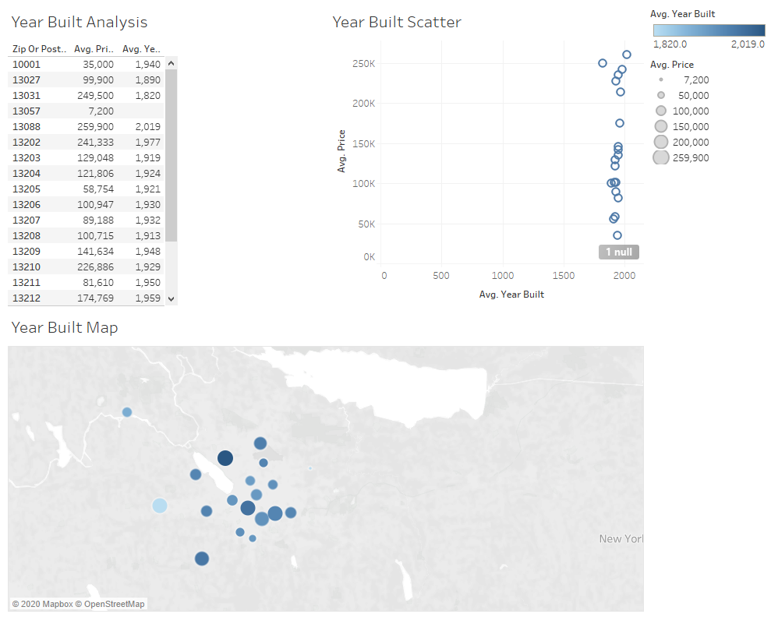

Slide 7
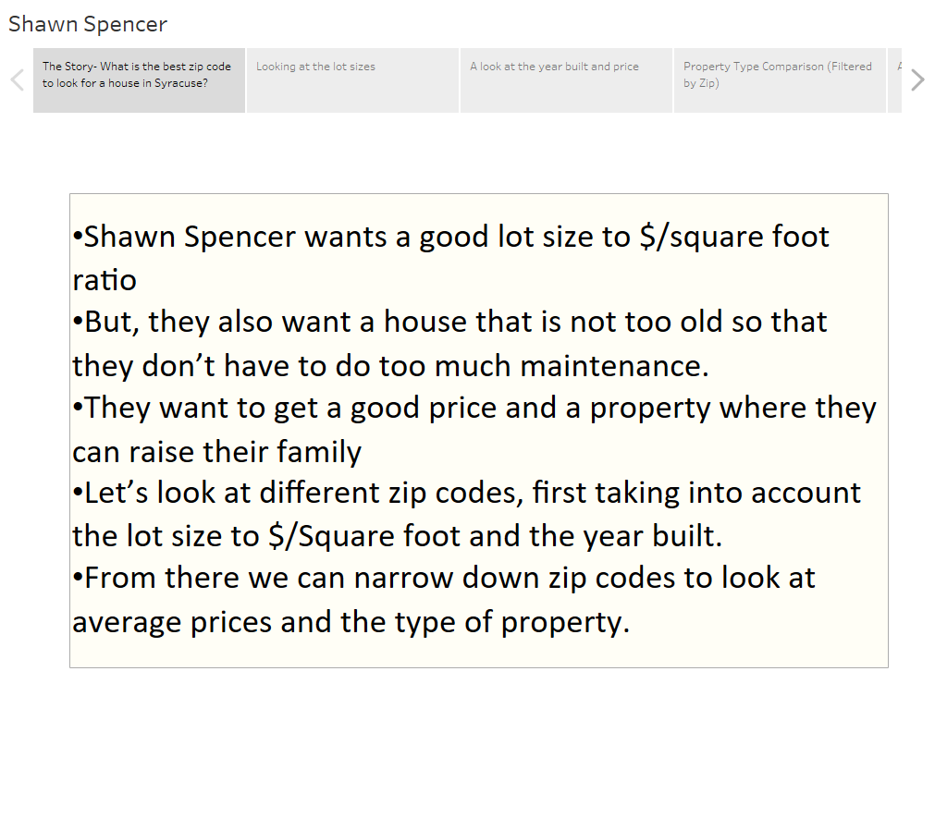

Slide 8
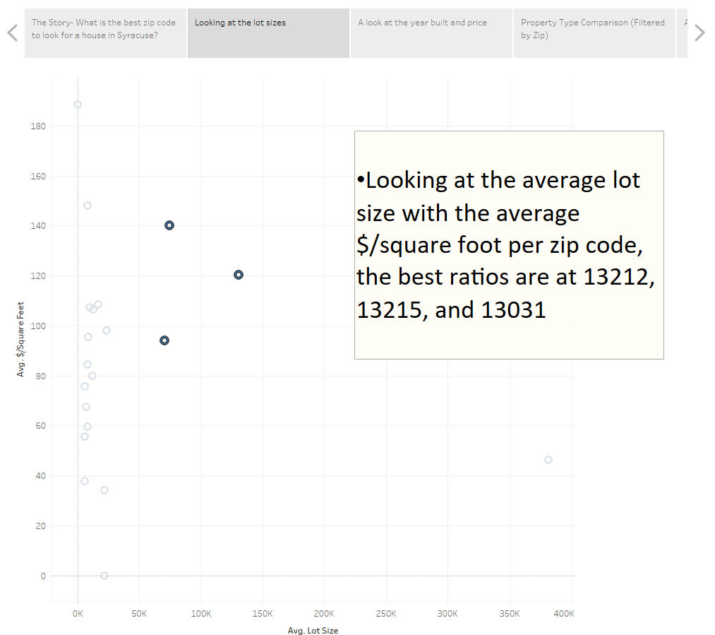

Slide 9
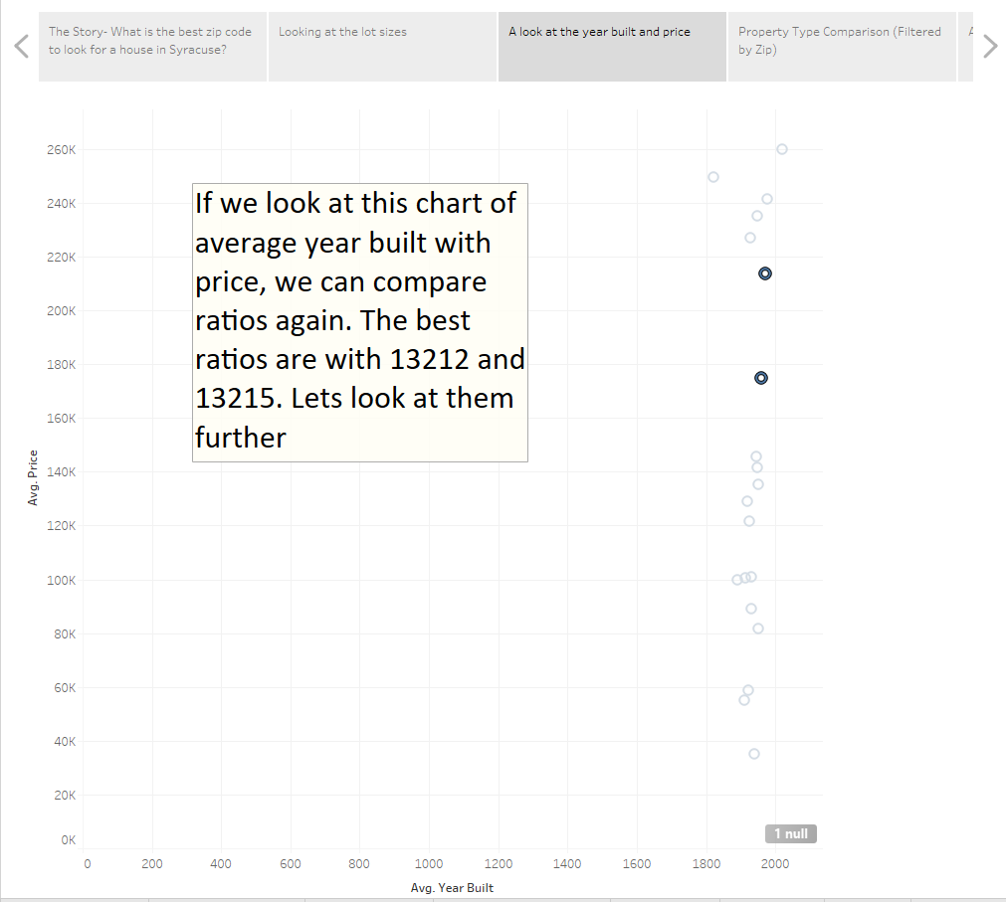

Slide 10
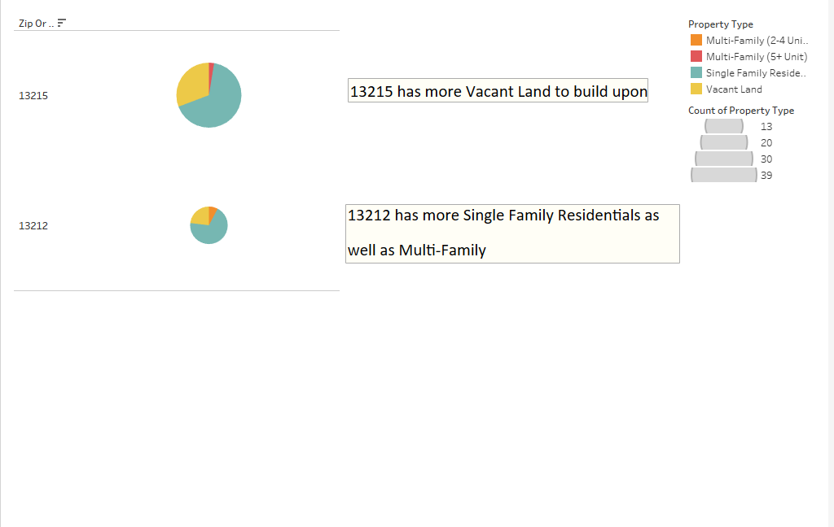

Slide 11
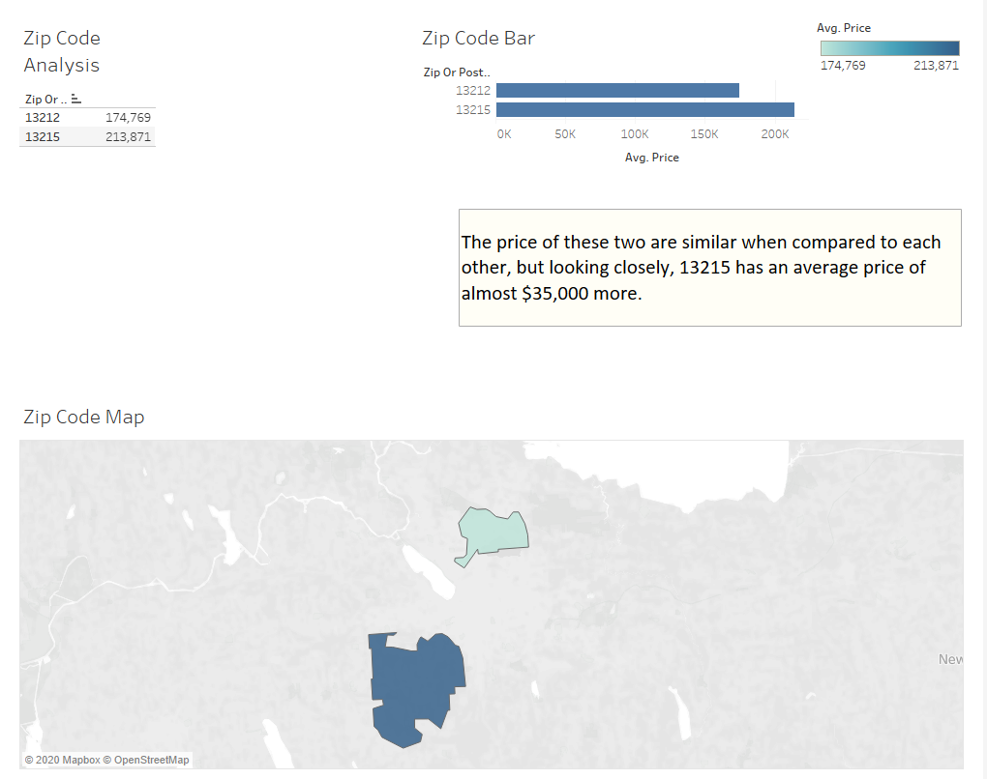

Slide 12
